Slide 1
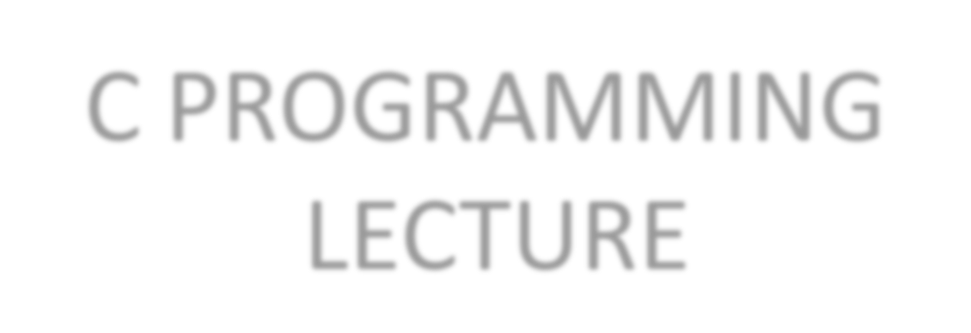
C PROGRAMMING
LECTURE
by
Deepak Majeti
M-Tech CSE
mdeepak@iitk.ac.in
17th August
IIT Kanpur
C Course, Programming club, Fall 2008

Slide 2
Recap
C is a high-level language.
Writing a C code. {editors like gedit, vi}
Compiling a C code. {gcc –c test.c –o test}
Executing the object code. {./test}
C Course, Programming club, Fall 2008

Slide 3
Some more basics
Keywords
    char, static, if , while, return ..................... Total= about 32
Data Types
    int , char, float ...………..….. Some more later
Arithmetic Operators
    + (Plus), - (Minus), * (Multiplication), /(Division)
        ……….………. Some more later
C Course, Programming club, Fall 2008

Slide 4
My first C program!
#include <stdio.h>
// program prints hello world
int main() {
printf ("Hello world!");
return 0;
}
Output: Hello world!
C Course, Programming club, Fall 2008

Slide 5
Example 1
#include <stdio.h>
// program prints a number of type int
int main() {
int number = 4;
printf (“Number is %d”, number);
return 0;
}
Output: Number is 4
C Course, Programming club, Fall 2008

Slide 6
Example 2
#include <stdio.h>
// program reads and prints the same thing
int main() {
int number ;
printf (“ Enter a Number: ”);
scanf (“%d”, &number);
printf (“Number is %d\n”, number);
return 0;
}
Output : Enter a number: 4
Number is 4
C Course, Programming club, Fall 2008

Slide 7
more and more
#include <stdio.h>
int main() {
/* this program adds
two numbers */
int a = 4; //first number
int b = 5; //second number
int answer = 0; //result
answer = a + b;
}
C Course, Programming club, Fall 2008

Slide 8
Note
Errors
Compilation
Compiler generally gives the line number at which the error is present.
Run time
C programs are sequential making the debugging easier.
C Course, Programming club, Fall 2008

Slide 9
Some more Data Types
Primary : int, float, char
  int (signed/unsigned)(2,4Bytes): used to store integers.
  char (signed/unsigned)(1Byte): used to store characters
  float, double(4,8Bytes): used to store a decimal number.
User Defined:
  typedef: used to rename a data type
    typedef int integer; can use integer to declare an int.
  enum, struct, union
C Course, Programming club, Fall 2008

Slide 10
Some more Arithmetic Operators
Prefix Increment : ++a
  example:
        int a=5;
        b=++a; // value of b=6; a=6;
Postfix Increment: a++
  example
        int a=5;
        b=a++; //value of b=5; a=6;
C Course, Programming club, Fall 2008

Slide 11
Contd…
Modulus (remainder): %
  example:
        12%5 = 2;
Assignment by addition: +=
  example:
        int a=4;
        a+=1; //(means a=a+1) value of a becomes 5
  Can use -, /, *, % also
C Course, Programming club, Fall 2008

Slide 12
Contd…
Comparision Operators: <, > , <=, >= , !=, ==, !, &&, || .
  example:
        int a=4, b=5;
        a<b returns a true(non zero number) value.
Bitwise Operators: <<, >>, ~, &, | ,^ .
  example
        int a=8;
        a= a>>1; // value of a becomes 4
C Course, Programming club, Fall 2008

Slide 13
Operator Precedence
Meaning of a + b * c ?
is it a+(b*c) or (a+b)*c ?
All operators have precedence over each other
*, / have more precedence over +, - .
  If both *, / are used, associativity comes into picture. (more on this later)
  example :
        5+4*3 = 5+12= 17.
C Course, Programming club, Fall 2008

Slide 14
Precedence Table
Highest on top
++ -- (Postfix)
++ -- (Prefix)
* / %
+ -
<< >>
< >
&
|
&&
||
C Course, Programming club, Fall 2008

Slide 15
Input / Output
printf (); //used to print to console(screen)
scanf (); //used to take an input from console(user).
  example: printf(“%c”, ’a’); scanf(“%d”, &a);
  More format specifiers
        %c The character format specifier.
        %d The integer format specifier.
        %i The integer format specifier (same as %d).
        %f The floating-point format specifier.
        %o The unsigned octal format specifier.
        %s The string format specifier.
        %u The unsigned integer format specifier.
        %x The unsigned hexadecimal format specifier.
        %% Outputs a percent sign.
C Course, Programming club, Fall 2008

Slide 16
Some more geek stuff
& in scanf.
  It is used to access the address of the variable used.
  example:
        scanf(%d,&a);
        we are reading into the address of a.
Data Hierarchy.
  example:
    int value can be assigned to float not vice-versa.
    Type casting.
C Course, Programming club, Fall 2008

Slide 17
Home Work
Meaning of
  Syntax
  Semantics of a programming language
Find the Output:
  value=value++ + value++;
  Value=++value + ++value;
  value=value++ + ++value;
C Course, Programming club, Fall 2008

Slide 18
End of Today’s Lecture
    Doubts && Queries?
C Course, Programming club, Fall 2008

Slide 19
THANK YOU
C Course, Programming club, Fall 2008

